Slide 1
COMPARISON BETWEEN POPULATION GROWTH AND COMMUTE DISTANCE
STUDENT ID of Member 1 – 24241163
STUDENT ID of Member 2 – 20390573

Slide 2
Data collection process: The data was collected by using the API key generated from Google Distance Matrix API. This collected data includes commute distance and time data from biggest towns in each county to Dublin city API key generation and configuration Google Maps API and data Retrieval Process Query Timestamps Methodology Consistency and Accuracy
Methodology:- Builds a query using the Google Distance Matrix API that has been collected. This API will return the Distance in meters and duration to commute in seconds. This data is formatted to display as Hours and Kilometres.
Consistency and Accuracy:- Pre-determined data slots have been used here(9AM in the morning , 7PM in the evening)

Slide 3
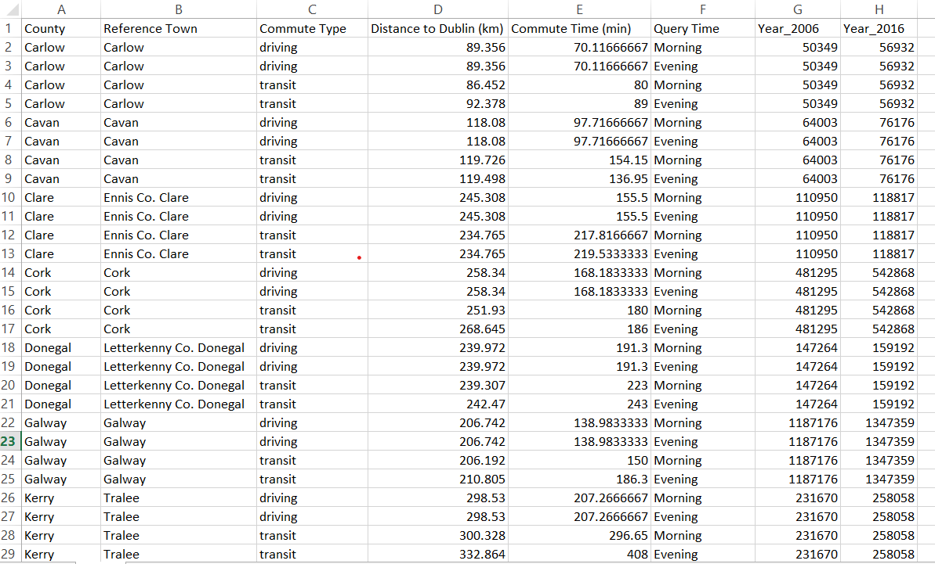
The csv file generated consists:

Slide 4
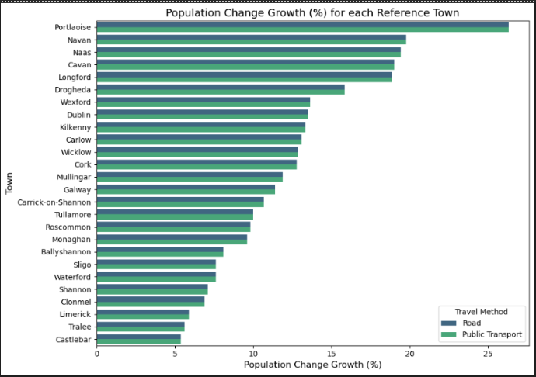
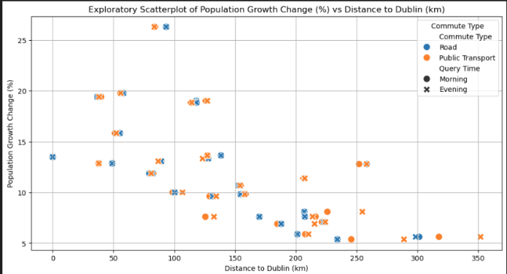
Exploratory Graphs:

Slide 5
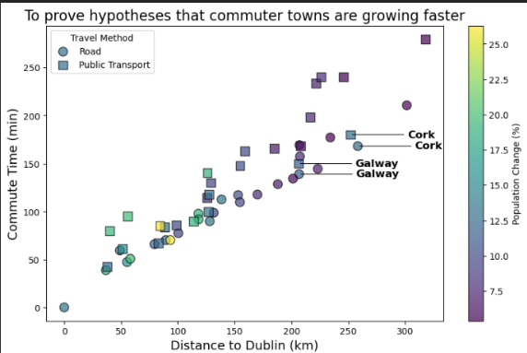
Explanatory Graph
The main exploratory visualisation produced after data collection and exploration is shown on the right.
The graph supports our hypothesis that town closer to Counties closer to Dublin had a higher increase in population growth from 2006 to 2016.
The graph shows this using a colour scale to represent population growth, Distance to Dublin on the x-axis and commute time on the y-axis.
It should be noted that 2 counties are outliers in terms of population growth and distance from Dublin. These are Cork and Galway and are labelled on the graph. This makes sense as the 2 counties contain large urban centers, so the authors of this graph believe our hypothesis still holds value.

Slide 6
Further Thoughts.
The colours used for the graph in slide 4 are colour-blind friendly
The colour scale used is the viridis scale from the matplotlib python library.
It is also clear from the graph that distance to Dublin and compute time have a linear relationship which would make sense.
It can also be seen from the graphs presented above that road travel is on average faster than public transport in Ireland.

